Slide 1
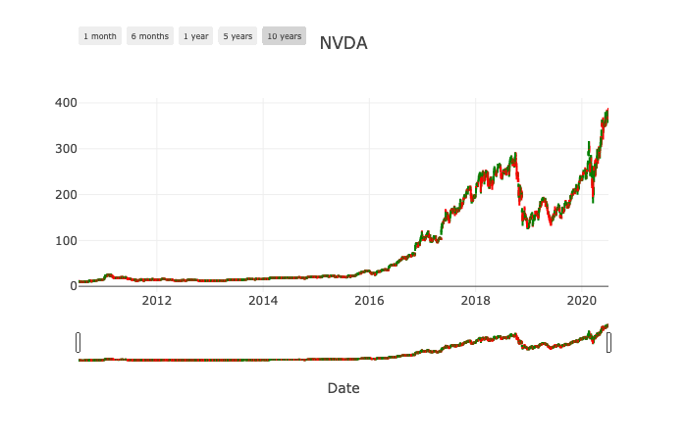
Return on Investment Portfolio Based On S&P 500
Presented by:
Ram Sake
Ravi Selva
Travis Le

Slide 2
Agenda Outline
1
Overview of investing and investor
2
Investment tool concept
3
How the tool works

Slide 3
Agenda Outline
1
Overview of investing and investor
2
Investment tool concept
3
How the tool works

Slide 4
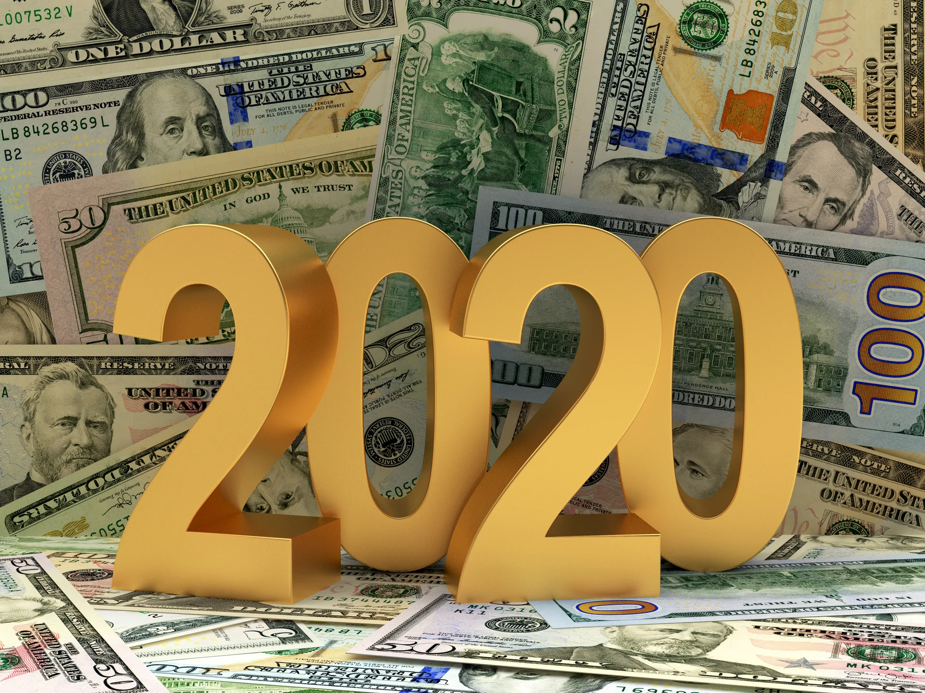
The reality checks of investing and investor
+
-
massive rise in the S&P 500 since 2009 – CAGR 43.79%
50% of Americans don’t know if it’s better to invest in a single stock or a fund.
Over the long term, no other type of investment tends to perform better
The reason 55% of Americans aren't investing boils down to them thinking they don't have money to do so .
Investing will help you build wealth and will get you to retirement (or early retirement) ...
Unable to own a partial share of a stock
https://www.cnbc.com/2020/02/19/50percent-of-americans-dont-know-how-to-diversify-their-investments.html
https://www.fool.com/retirement/2019/07/28/the-reason-55-of-americans-arent-investing.aspx
http://news.morningstar.com/classroom2/course.asp?docId=142857&page=3

Slide 5
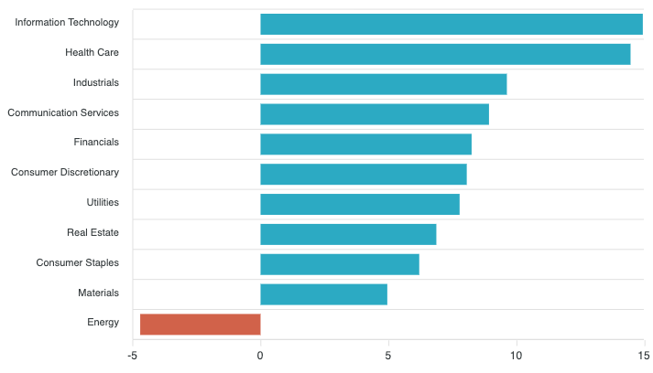
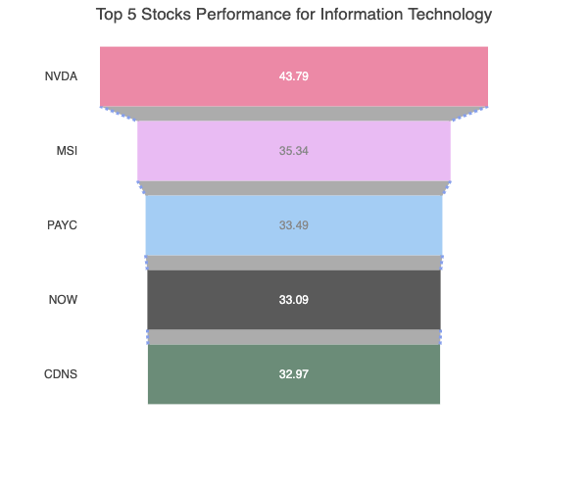
Best sectors to invest for next decade – Technology enabler
Industry/Sector
Best sector
Rationale to be the best sector
Stock sample
Technology
At the forefront of innovation and at the center of the Information Age, which has shaped the economy over the past 20 years and looks to continue that trend for the foreseeable future
That said, innovations in areas such as cybersecurity and artificial intelligence will create massive markets and revenue sources for tech companies. Cybersecurity alone is predicted to be a $165bn industry by 2023,
Health care
Aging population and rapid advances in biotechnology
Demand of good living standard
Industrials (Automotive)
with a 2017 study by Intel predicting that the driverless car market will be worth $800bn in 2035 – and $7 trillion by 2050.
Retail
eCommerce is expected to account for 20% of all retail sales by the end of the next decade
Virtual shopping personalization services should help the industry grow from 1.5 trillion now to 2 trillion by 2026.
https://www.thebalance.com/best-sectors-to-invest-for-the-long-term-2466351
https://www.startingbusiness.com/blog/fastest-growing-industries-decade

Slide 6
Agenda Outline
1
Overview of investing and investor
2
Investment tool concept
3
How the tool works

Slide 7
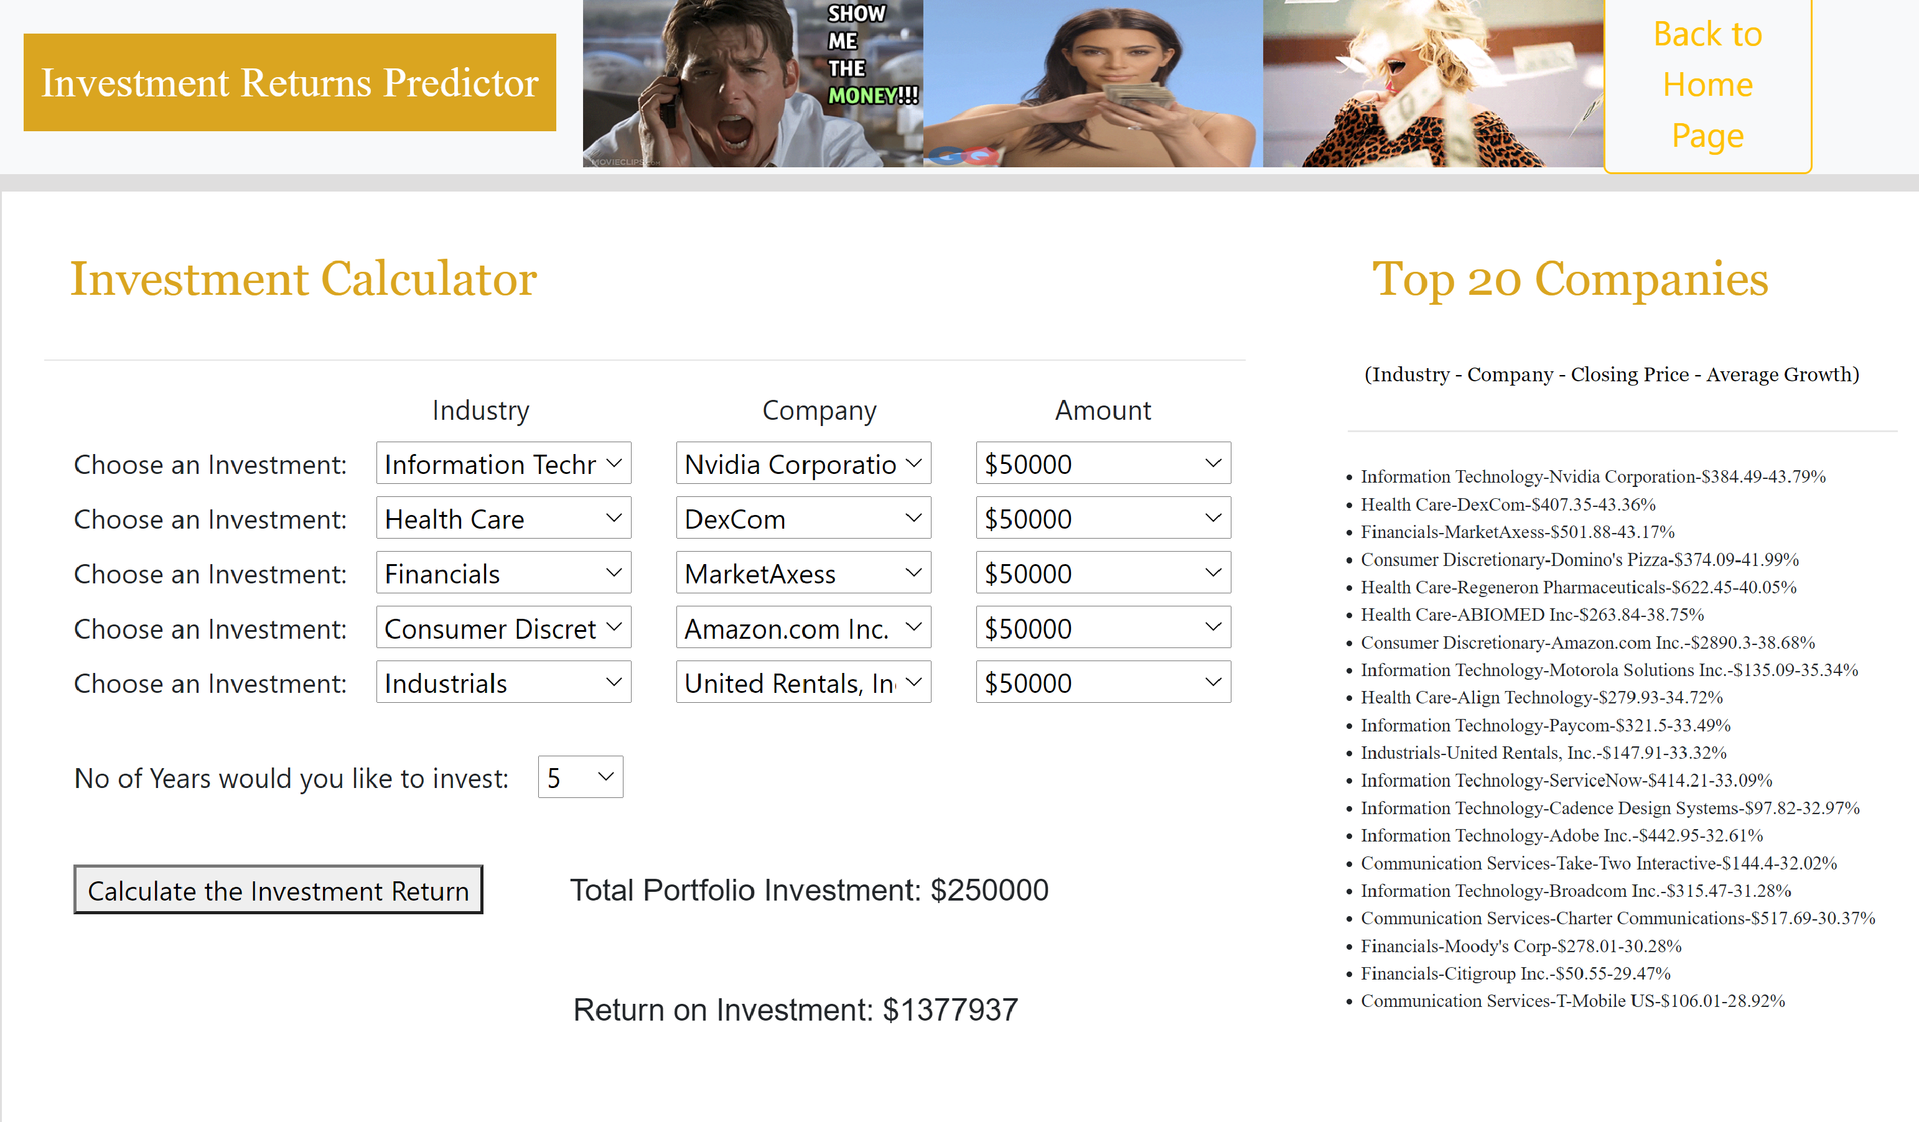
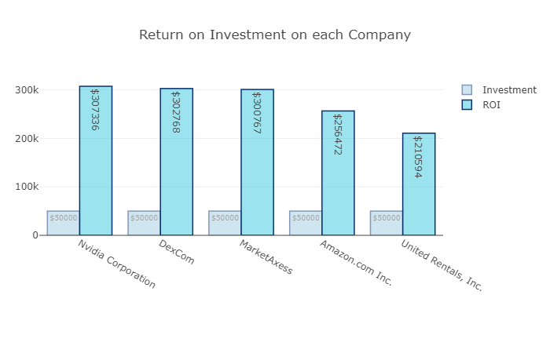
Logical flow of stock selection
Select Industry
Select stocks
Input the investment amount
investment tenure
AI Engine
ROI Result
1
2
3
4
4
Top Industries
YEAR
5,10,15
1
Fastest growth industry in past years
AI Engine
Top companies in the industries
Portfolio
ROI
2
Investment amount
3

Slide 8
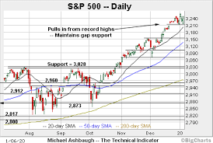





Why to consider our product & service?
Full view of S&P 500 Performance and sectors
Tool is easy to use
Link to research update
Top Stocks performance in past years
predictive investment return within few clicks.
Safe and secure

Slide 9
Agenda Outline
1
Overview of investing and investor
2
Investment tool concept
3
How the tool works

Slide 10

Demo

Slide 11


